Slide 1

Air Quality Analysis and prediction using machine learning
Review-2
Under Guideance
of
Dr. Anjali Gautham
By
N .Vinod Kumar

Slide 2
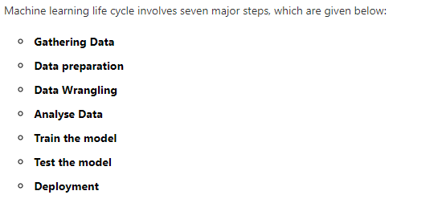

Slide 3
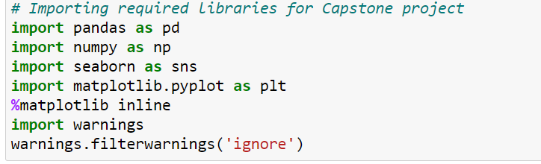
Data Collection
Importing required libraries for capstone project
Importing dataset from local Machine to dataframe

Slide 4
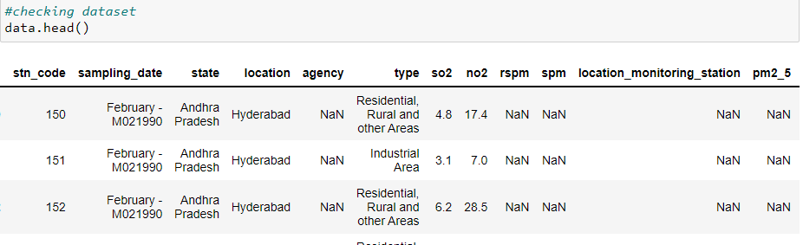
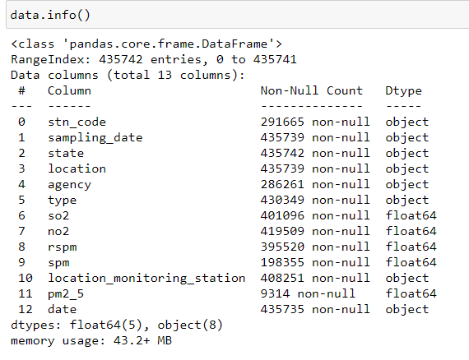
Checking dataframe
General Overall Information about imported dataset

Slide 5
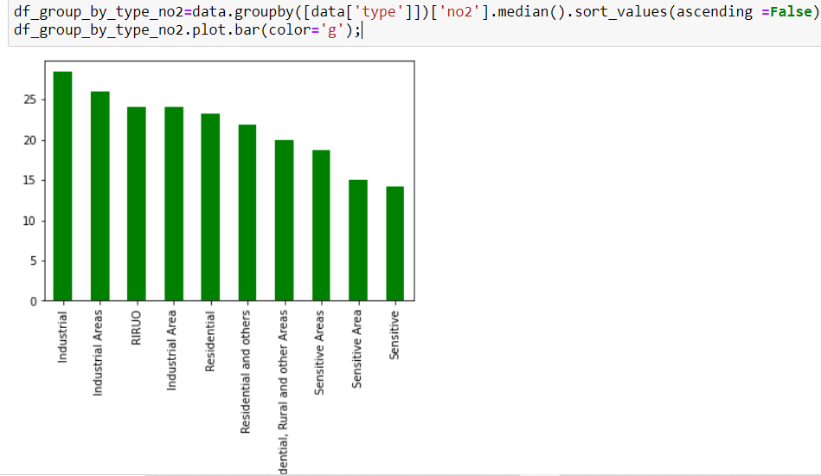
Analysing Data (EDA)
Distribution and Trend of Nitrogen Dioxide(No2) emission

Slide 6
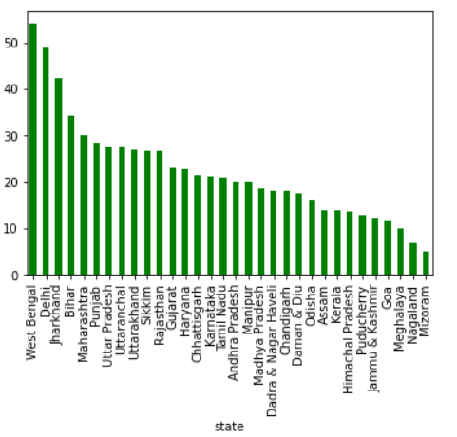
The Graph represents that West Bengal,Delhi and Jharkhand are the top most Nitrogen dioxide exposed states

Slide 7
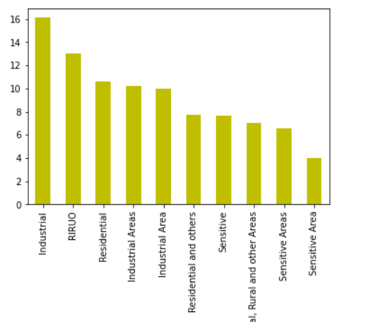
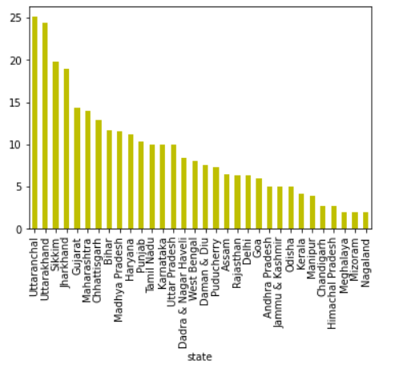
Distribution and Trend of Sulphor Dioxide(So2) emission

Slide 8
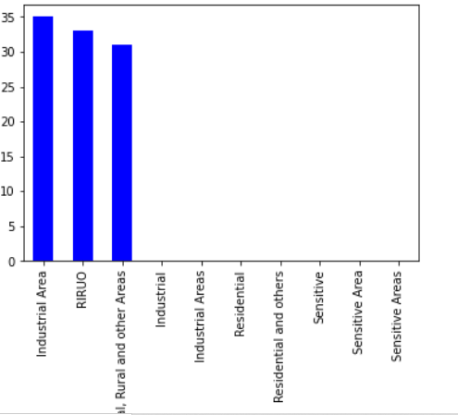
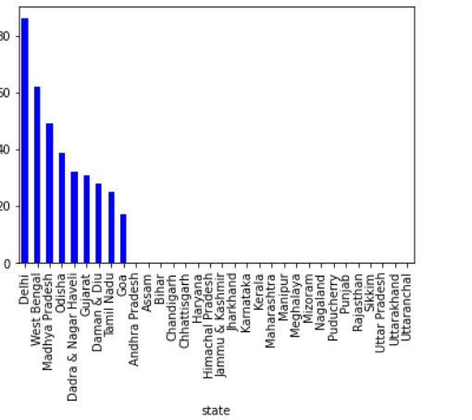
Distribution and Trend of Particulate matter(Pm2_5) emission

Slide 9
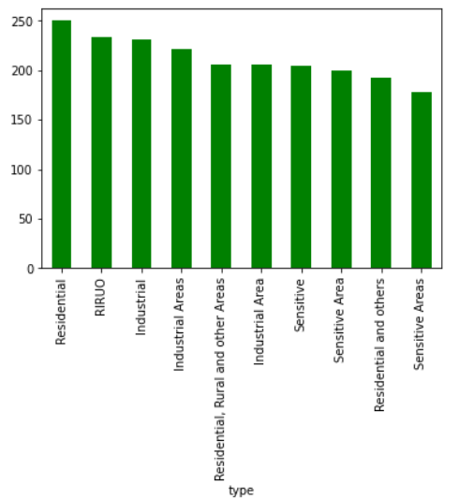
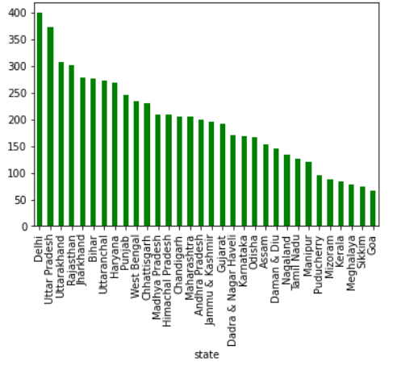
Distribution and Trend of SPM emission

Slide 10
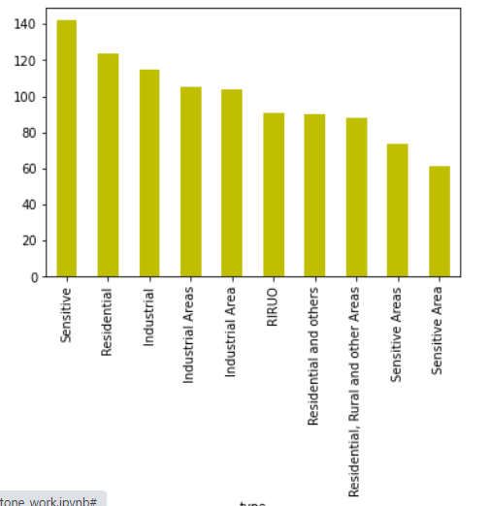
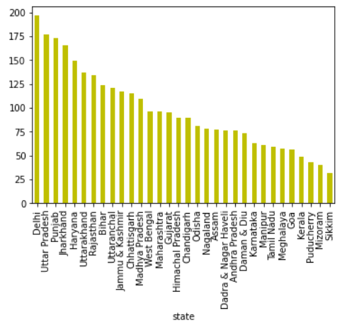
Distribution and Trend of RSPM emission

Slide 11
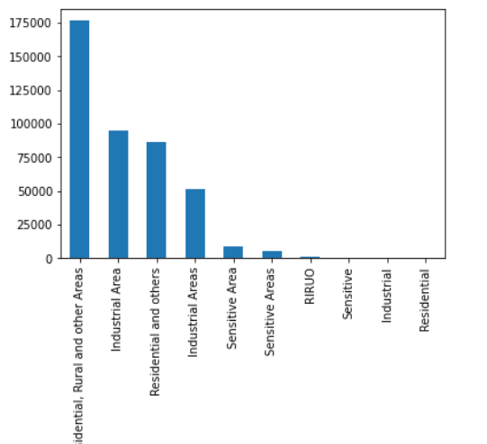
We can see the maximum of the data is recorded from the residential and rural areas followed by Industrial area

Slide 12
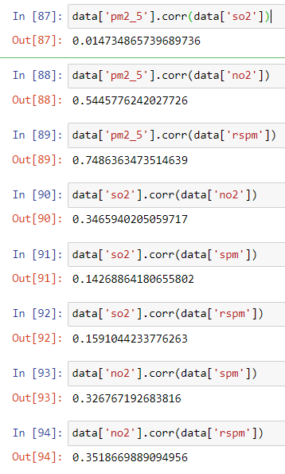
Checking corelation between Features
Obviously, we can see high correlation between RSPM and PM2.5
We can conclude that increase of any one Feature lead to increase of other Feature

Slide 13
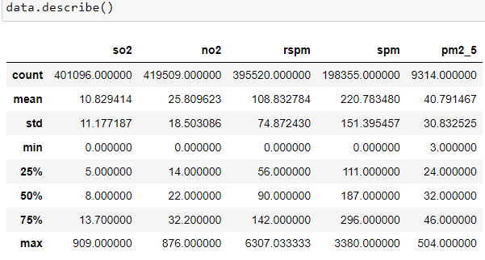
Data Preparation
Statistical Description of data before perfoming Feature Engineering

Slide 14
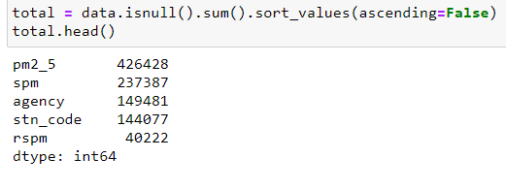
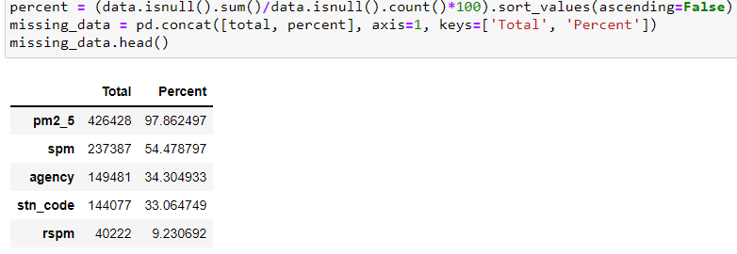
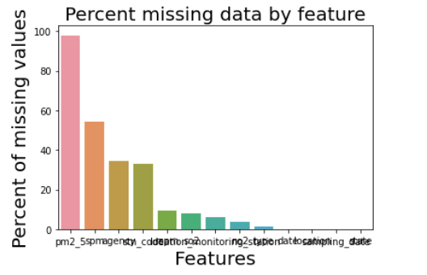
Checking Null Values
Representing
Percentage of MISSING Values in Columns
Using Histogram

Slide 15
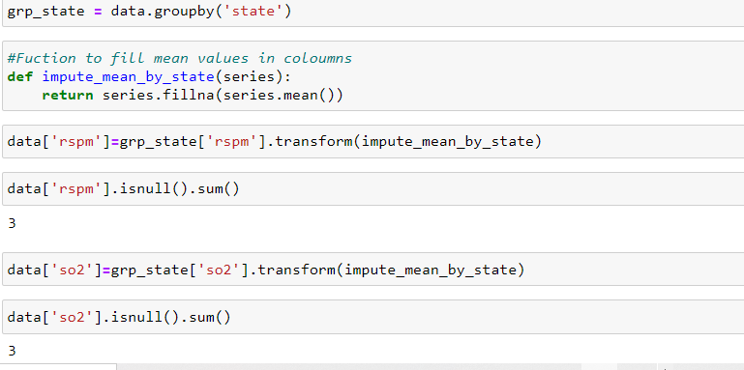
Filling NULL valued Coloumns with its Mean Using Function

Slide 16
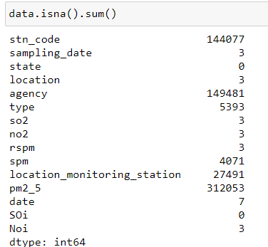
Columns after filling Null Values

Slide 17
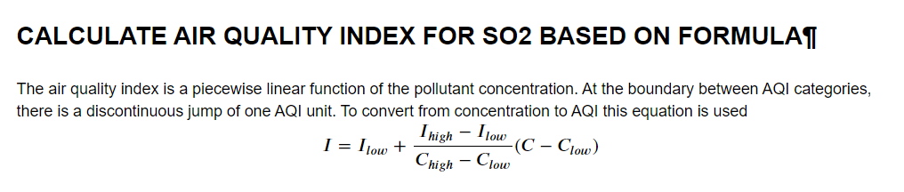
General Formula to Create index for particular Coloumns

Slide 18
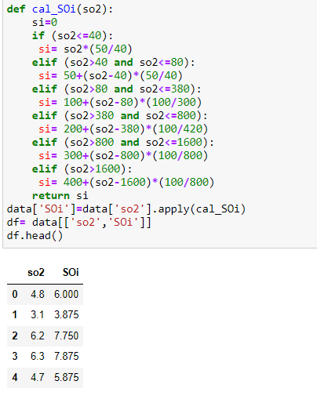
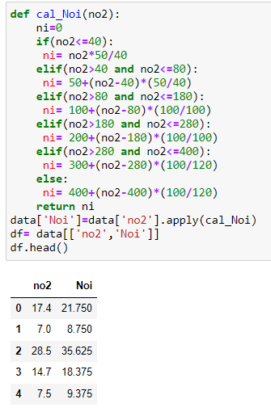
Creating Soi using so2
Creating Noi using no2

Slide 19
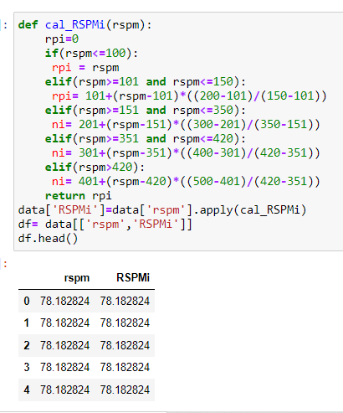
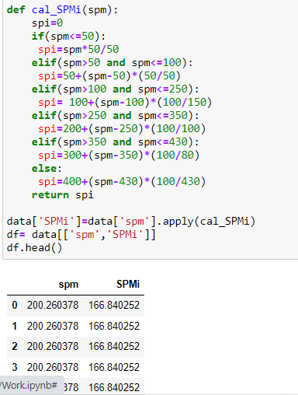
Creating RSPMI using rspm
Creating SPMi using spm

Slide 20
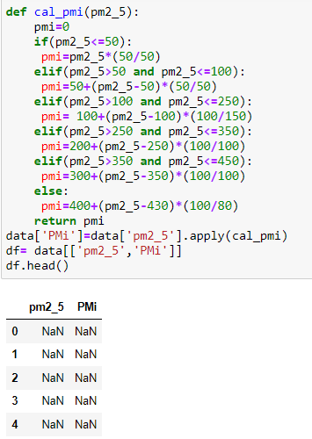
Creating PMi using pm2_5

Slide 21
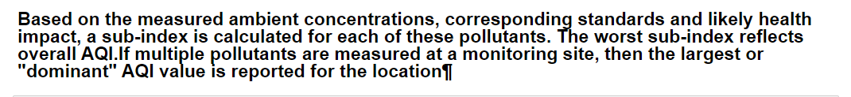
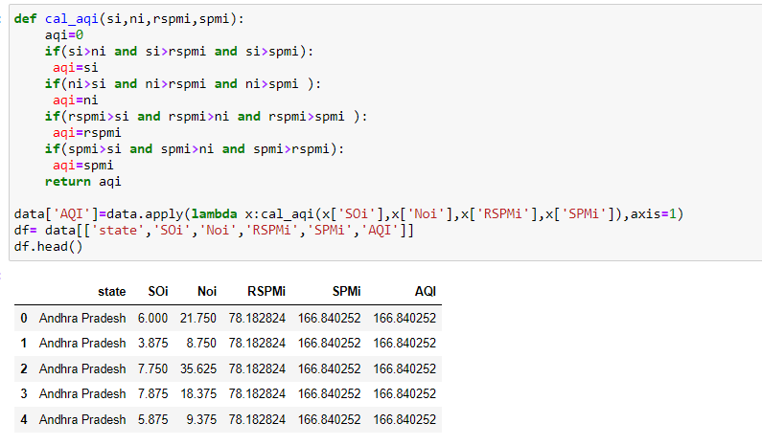
Creating AIRQUALITY INDEX using so2,no2,spm,rspm

Slide 22
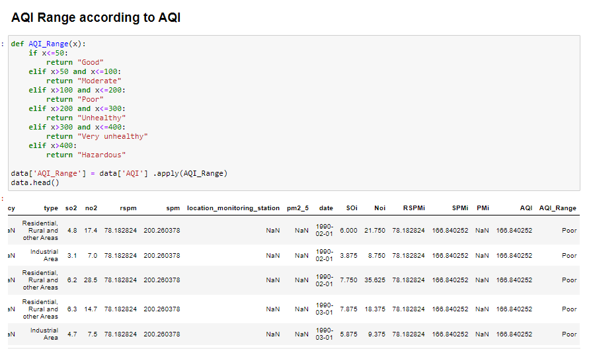

Slide 23
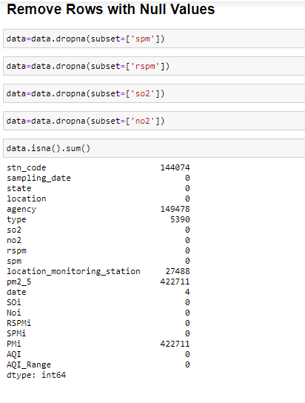

Slide 24
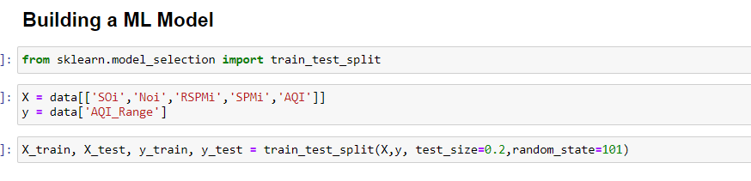
Training and Testing Data

Slide 25
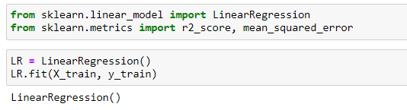


Linear Regression

Slide 26
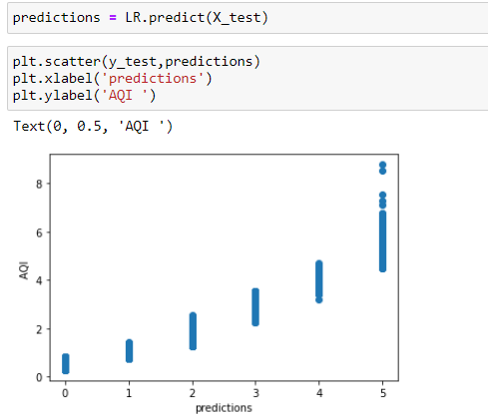

Slide 27
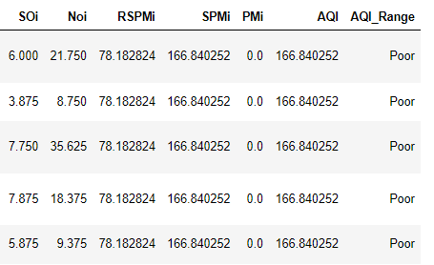
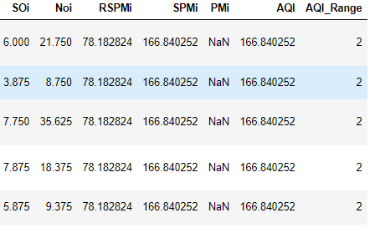

Checking Prediction
0 Good
-Moderate
-Poor
-Unhealthy
-Very-Unhealthy
-Hazardeos

